Slide 1
Institute for Healthcare Improvement Open School UBC Chapter
September 29, 2014

Slide 2
Adverse
Event

Slide 4
IHI UBC
VISION: a future generation of skilled, passionate changemakers that create an efficient, effective and safe healthcare system
MISSION: to equip students with skills, knowledge and opportunities to advance healthcare quality improvement and patient safety

Slide 5
IHI UBC Leadership
Faculty Advisor
President
Communi-cations
Treasurer
Faculty Advisor
Scholarship
Curriculum
Faculty Advisor
QI Observer-ships
Events
Faculty Advisor
QuIP
workshops

Slide 6
IHI UBC Opportunities
Awareness
Engagement
Practical Experience
Mentorship
Speaker Series
QuIP Workshop Series
Student Scholarship
Observership Program

Slide 7
Speaker Series
What: The IHI Speaker Series events feature free lectures by local Quality Improvement leaders to offer a space for students and healthcare professionals to learn, connect, and share ideas.
This year, we hope to deliver a speaker series surrounding the topic of "Evidence Based Medicine - Family Physicians on Prescribing Decisions" featuring speakers in healthcare.

Slide 8
Speaker Series
When: We will be having two lectures in November and February, followed by the annual panel event in March.
Who: You! Our speaker series encourages undergraduate and graduate students, medical students, patients, and healthcare workers to interact and share their insights and experiences about improving healthcare.

Slide 9
QuIP Workshop Series
A brand new initiative from IHI UBC to be launched this fall!!
A series of workshops exploring principles and techniques related to health care improvement
Fall series: Quality Improvement
Spring series: Patient Safety

Slide 10
QuIP Workshop Series
Based on the IHI Open School modules online
A series of four 50 minute lunch time workshops with…
Exciting guest speakers with expertise in the field
Interactive, hands-on, and multimedia approach
….and free lunch!
A certificate of completion will be awarded to students who attend all four workshops
Open to students from all academic backgrounds

Slide 11
QuIP Workshop Series
Fall series: Quality Improvement
Where: UBC Point Grey Campus
Life Sciences Centre, Room 1312 (CMR)
When:
October 14: “Human Factors and Barriers to Change”
October 21: “Overcoming Barriers to Change in QI”
October 28: “Plan, Do, Study, Act”
November 4: “Reviewing and Formulating Projects in QI”

Slide 12
Student Scholarship
IHI UBC & BCPSQC offers a scholarship to support students in pursuing educational opportunities to develop knowledge and skills in healthcare quality improvement!

Slide 13
Student Scholarship
Elligibility
Full-time UBC students in a health-related discipline
IHI UBC members

Slide 14
Student Scholarship
Required Materials:
1. Letter of intent 2. Current Resume 3. Additional information

Slide 15
Student Scholarship
Deadline for submission: Friday October 10th, 2014 at 9pm.
Please email the required documents to scholarship@ihiubc.com (with subject line: IHI Scholarship Application)

Slide 16
Observership Program
What: A unique opportunity for students to gain real-world insight into the administrative and business-related processes in health care to improve the quality of care and safety of patients
How: You’ll be matched with an experienced healthcare professional working in quality improvement at Vancouver Coastal Health to shadow and learn for a day
5 different mentors working in areas such as: human factors, NSQIP, infection control, and accreditation

Slide 17
Observership Program
Why Should I Participate?
Gain valuable insight into healthcare quality improvement and how it impacts the health system and patients, both practically and theoretically
Establish a relationship with an experienced health care professional

Slide 18
Observership Program
How Can I Apply?
Go to www.ihiubc.com/observerships
Register using the online form and complete 3 short IHI Open School Courses (~ 1 hr) to gain theoretical understanding of QI to support your observership

Slide 19
Observership Program
UBC IHI Practicum Opportunity
We are working to pilot a practicum opportunity in the coming months
The practicum would allow for a longer relationship with a mentor where you can gain more practical experience implementing the Model of Improvement and PDSA cycles for a real health care problem
Please contact Kan Cheung or Marissa Mar at observerships@ihiubc.com to learn more of these coming opportunities!

Slide 20
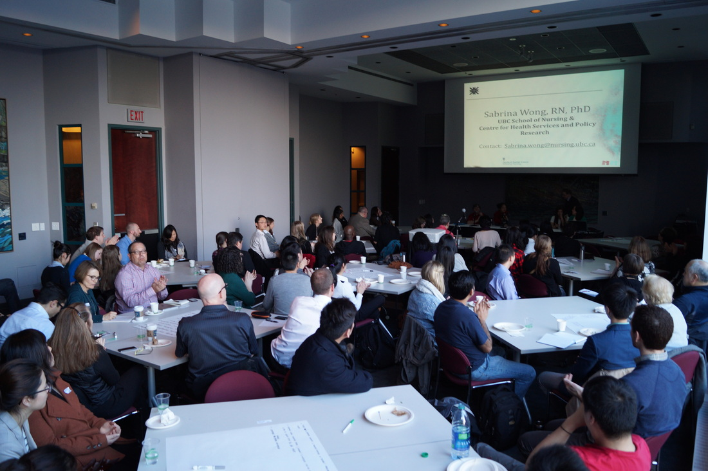
www.ihiubc.com

Slide 21
Icebreaker Activity
Emergency Department Flow Game:
Get into groups of 5!

